Slide 1
Indian Sign Language To Text/Speech Translation
PIP4004 University Project
Final Review
Batch Number: CIT - G21
Roll Number 20211CIT0042 20211CIT0140 20211CIT0164 20211CIT0166 20211CIT0170 | Student Name Venkat Navya S Manisha R Challa Shalini P Durga Prasheena Chavva Rajeswari
Under the Supervision of,
Mr. E. Sakthivel
Assistant Professor
School of Computer Science and Engineering
Presidency University
Name of the Program: CSE
Name of the HoD: Dr. Anandaraj S P
Name of the Program Project Coordinator: Dr. Sharmasth Vali
Name of the School Project Coordinators: Dr. Sampath A K / Dr. Abdul Khadar A / Mr. Md Ziaur Rahman

Slide 2
Content
ØIntroduction
Ø Literature Review
Ø Objectives
Ø Methodology
Architecture
Hardware/Software Components
Ø Timeline for Execution
Ø Expected Outcomes
Ø Conclusion
Ø References

Slide 3
Introduction
Sign language uses manual and visual mode to convey what the person thinks, feels and experiences. There are three major sign languages in the world: American Sign Language (ASL), Pidgin Signed English (PSE) and Signed exact English (SEE). All the three standardized sign languages are in English. For the local citizens of India, a foreign language like English would never become a major sign language because people normally learn to speak in their mother tongue which is not English.
On the other hand, there are a variety of sign languages present throughout India. The different parts of India have little difference in signing but the grammar remains the same throughout the country. Hence, a sign language that is standardized and can be used by anyone who is deaf and mute and understood by the normal people is mandatory.
Therefore, just like Hindi is the national language and is known by majority of the citizens, which makes communication efficient, Indian Sign Language has to be standardized. There are many institutes that teach different sign language to the teachers being trained leading to different sign languages. The crux of the problem lies in little to no knowledge about this. In a diverse country like India, unifying or standardizing a sign language is complex. The solution for this must be generic as well as adaptive taking into regard the Indian diversity. Use of an external hardware is not required in our approach.

Slide 4
Literature Review
Author(s) | Paper Name | Year | Merits | Demerits | Accuracy | Methodology
Sharma, P. et al. | Translating Speech to Indian Sign Language Using NLP | 2022 | Uses NLP for translation; enhances accessibility | Limited dataset size | 85% | NLP-Based translation
Grover, Y. et al. | Sign Language Translation Systems for Hearing/Speech Impaired People: A Review | 2021 | Comprehensive review; highlights key advancements | Lacks experimental validation | N/A | Review Paper
Sharma, A. et al. | Sign Language to Speech Translation | 2020 | Real-time conversion; practical application | Accuracy depends on gesture recognition | 80% | Machine Learning
Akshatharani, B. K. et al. | Sign Language to Text-Speech Translator Using Machine Learning | 2021 | Uses ML for high accuracy | Dataset constraints | 87% | Deep Learning
Bharathi, C. U. et al. | Signtalk: Sign Language to Text and Speech Conversion | 2021 | Integrates text and speech output | Limited to specific signs | 82% | AI-based approach
6

Slide 5
Author(s) | Paper Name | Year | Merits | Demerits | Accuracy | Methodology
Garg, H. et al | Real-Time Conversion for Sign-to-Text and Text-to-Speech Communication Using ML | 2024 | Bidirectional communication | High computational requirements | 88% | Machine Learning
Goyal, L. et al. | Text to Sign Language Translation System: A Review | 2016 | Covers various translation methods | Outdated methodologies | N/A | Review Paper
Tiku, K. et al. | Real-time Conversion of Sign Language to Text and Speech | 2020 | Real-time processing | Limited language support | 83% | Machine Learning
Sindhu, K. S. et al. | Sign Language Recognition and Translation Systems for Enhanced Communication | 2024 | Enhanced recognition system | Limited generalization | 85% | Deep Learning
Sheela, K. A. et al. | Indian Sign Language Translato | 2024 | Includes sentiment analysis | Limited dataset availability | 82% | AI-based

Slide 6
Existing method Drawback
Limited Dataset Availability – Existing systems lack large, diverse datasets for Indian Sign Language (ISL), leading to lower accuracy in real-world scenarios.
Gesture Complexity – ISL involves dynamic gestures, facial expressions, and hand orientations, making it challenging for traditional models to interpret accurately.
Device Dependency – Many systems require specialized gloves or sensors, making them costly and less accessible for everyday users.
Lack of Real-time Processing – Some existing methods have high latency, making real-time communication difficult.
Poor Generalization – Models trained on specific datasets may struggle with variations in hand size, lighting conditions, and backgrounds, reducing effectiveness in diverse environments.
Limited Support for Regional Variations – ISL has multiple regional variations, but existing systems often support only standard gestures.
Lack of Facial Expression Recognition – Expressions play a key role in ISL, but many systems fail to capture and interpret them effectively.

Slide 7
Proposed Methodology
Image acquisition- The initial or the first step of this system is vision based i.e. to acquire images at runtime via the camera. Then, these images will be stored in a directory, in which all the images will be stored and trained by the user and the saved & trained images will be used to compare the recently captured image to the previous images of a specific letter.
Feature Extraction- The palm is extracted from the images via image segmentation. The purpose of Image Processing in our project is Image Retrieval i.e. seeking for the image of interest and Image Recognition i.e. distinguishing the objects of image. The images are first converted to grayscale from colored. The background data being unnecessary is therefore removed as the bit size also reduces when it comes to saving the image as data which can be further trained. This is done with the help of algorithms like Gaussian Blur, Median Blur and Contour.
Gesture Recognition- Once the above steps are completed, the application will then match the recognized character with the already saved and trained data in our database. For the database, the user can either train one and keep it in the same application or import it via cloud example Google Colab. The Gestures are checked once the thresh is set by the user. Upon recognition, the program stands executed. Thus, displaying the text of the input sign. If the sign is not recognized, the program will be executed once again right from the start.

Slide 8
Proposed Methodology
Text to Speech - As and when the character is recognized, the output will then be further converted from text to speech. Here we use pyttsx3 which is a text to speech conversion library in Python. The output text is converted to speech by pyttsx3. It works offline, unlike alternative libraries, and is compatible with both Python 2 and Python 3. We can see and hear the sign language translation in our system at that same time and that makes it convenient to use.

Slide 9
Objectives
To develop a real-time system that translates Indian Sign Language (ISL) gestures into text and speech.
To enhance communication accessibility for the deaf and hard-of-hearing community by bridging the gap with non-sign language users.
To utilize computer vision and deep learning for accurate hand gesture recognition and classification.
To implement a scalable and efficient model capable of recognizing both static and dynamic ISL gestures.
To develop a user-friendly interface for easy interaction, ensuring accessibility on desktop and mobile platforms
To support multi-language text-to-speech conversion, enabling communication in English, Hindi, and other regional languages.
To ensure real-time processing with minimal latency for seamless interaction in daily communication.
To contribute to inclusivity and social impact by making technology more accessible to people with hearing disabilities in education, workplaces, and public spaces.

Slide 10
Methodology/Modules
1. Data Collection & Preprocessing
Collect an Indian Sign Language (ISL) dataset from publicly available sources or create a custom dataset.
Perform image preprocessing (resizing, noise removal, grayscale conversion, background subtraction).
Apply data augmentation techniques (rotation, flipping, contrast adjustment) to improve model generalization.
2. Hand Detection & Feature Extraction
Use MediaPipe, OpenCV, or YOLO for real-time hand tracking and landmark detection.
Extract key features such as finger positions, movement trajectories, and hand orientation.
Normalize hand landmarks to make gesture recognition independent of hand size and distance from the camera.
3.Gesture Recognition using Deep Learning
Train a CNN (Convolutional Neural Network) or Hybrid CNN-LSTM model to classify static and dynamic ISL gestures.
Implement LSTM (Long Short-Term Memory) networks for recognizing sequential gestures.
Fine-tune the model using transfer learning with pre-trained networks like MobileNet, ResNet, or EfficientNet.

Slide 11
Continued…
4. Gesture-to-Text Conversion
Map the recognized gesture to its corresponding textual representation using a predefined ISL vocabulary.
Implement an error correction mechanism to improve recognition accuracy.
Handle dynamic word formation by recognizing gesture sequences (e.g., spelling words letter by letter).
5. Text-to-Speech (TTS) Conversion
Convert the recognized text into natural-sounding speech using Google TTS, Microsoft Speech API, or Festival TTS.
Provide language customization to support Hindi, English, and other regional languages.
Enable speed and pitch modulation for better speech clarity.

Slide 12
Continued…
6. Real-Time Application Development
Develop a desktop or mobile application for real-time ISL translation.
Integrate camera support for live gesture recognition.
Implement offline mode support for areas with limited internet connectivity.
7. Performance Evaluation & Optimization
Test the system on real-world data with different users, lighting conditions, and backgrounds.
Measure key performance metrics: accuracy, processing speed, and user-friendliness.
Optimize the model using quantization, pruning, and edge computing for deployment on mobile devices.

Slide 13
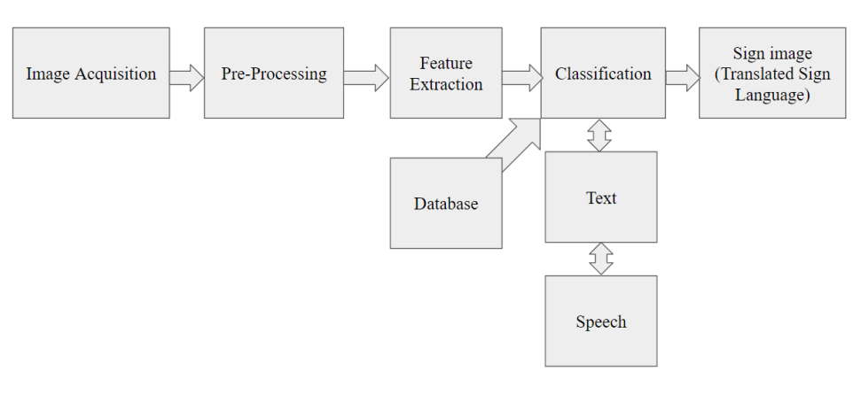
Architecture

Slide 14
Hardware/software components
Software Requirements:
Python 3.9.0
OpenCV
Jupyter Notebook
Streamlit
Hardware Requirements:
Web Cameras for detecting the gestures of user. The captured images were then sent for further processing. The output will be in the form of speech using speakers. Microphones are used to capture the user's speech for processing followed by translating it into sign images.

Slide 15
Timeline of Project
DESIGN
18/02/2023
BUILD
17/03/2025
TEST
16/04/2025
REVIEW
10/05/2025
PLAN
29/01/2025
REVIEW 0
REVIEW 1
REVIEW 2
REVIEW 3
FINAL REVIEW

Slide 16
Expected Outcomes
Real-time Indian Sign Language (ISL) Translation – The system will accurately recognize ISL gestures and convert them into text and speech
Improved Communication Accessibility – Bridges the communication gap between the deaf community and non-sign language users.
High Accuracy Gesture Recognition – Achieves reliable performance using deep learning-based models.
Support for Both Static and Dynamic Gestures – Recognizes alphabet signs, words, and continuous gesture sequences.
Multilingual Text-to-Speech Conversion – Converts ISL gestures into speech in English, Hindi, and other regional languages.
User-Friendly Application – A simple and intuitive interface for real-time ISL translation on desktop or mobile devices.
Cost-Effective and Hardware-Free Solution – Eliminates the need for expensive gloves or additional sensors.
Adaptability to Different Environments – Works under various lighting conditions, backgrounds, and user hand variations.
Social Impact and Inclusivity – Promotes accessibility in education, workplaces, and public spaces for individuals with hearing disabilities.

Slide 17
Conclusion
The Indian Sign Language to Text/Speech Translation project successfully bridges the communication gap between the deaf community and non-sign language users. By leveraging computer vision and deep learning, the system accurately recognizes ISL gestures and converts them into text and speech in real time.
The proposed solution eliminates the need for expensive external hardware, making it a cost-effective and accessible tool for daily communication. With features like multilingual support, offline functionality, and adaptability to various environments, this project has the potential to create a significant social impact in education, workplaces, and public interactions.
Future enhancements could include expanding the gesture vocabulary, incorporating facial expression recognition, and optimizing for mobile deployment, further improving accessibility and inclusivity.
This project is a step toward a more inclusive and communication-friendly society for individuals with hearing disabilities.

Slide 18
Github Link
The Github link provided should have public access permission.
Github Link:
https://github.com/shalinireddychalla/Indian-Sing-Language-to-Text-Speech-translation

Slide 19
IEEE Reference Papers
https://ieeexplore.ieee.org/abstract/document/9388330
https://ieeexplore.ieee.org/abstract/document/9675751
https://ieeexplore.ieee.org/abstract/document/10530832
https://ieeexplore.ieee.org/abstract/document/9182877
https://ieeexplore.ieee.org/abstract/document/10027108
http://ieeexplore.ieee.org/abstract/document/9885562
https://ieeexplore.ieee.org/abstract/document/10774893

Slide 20
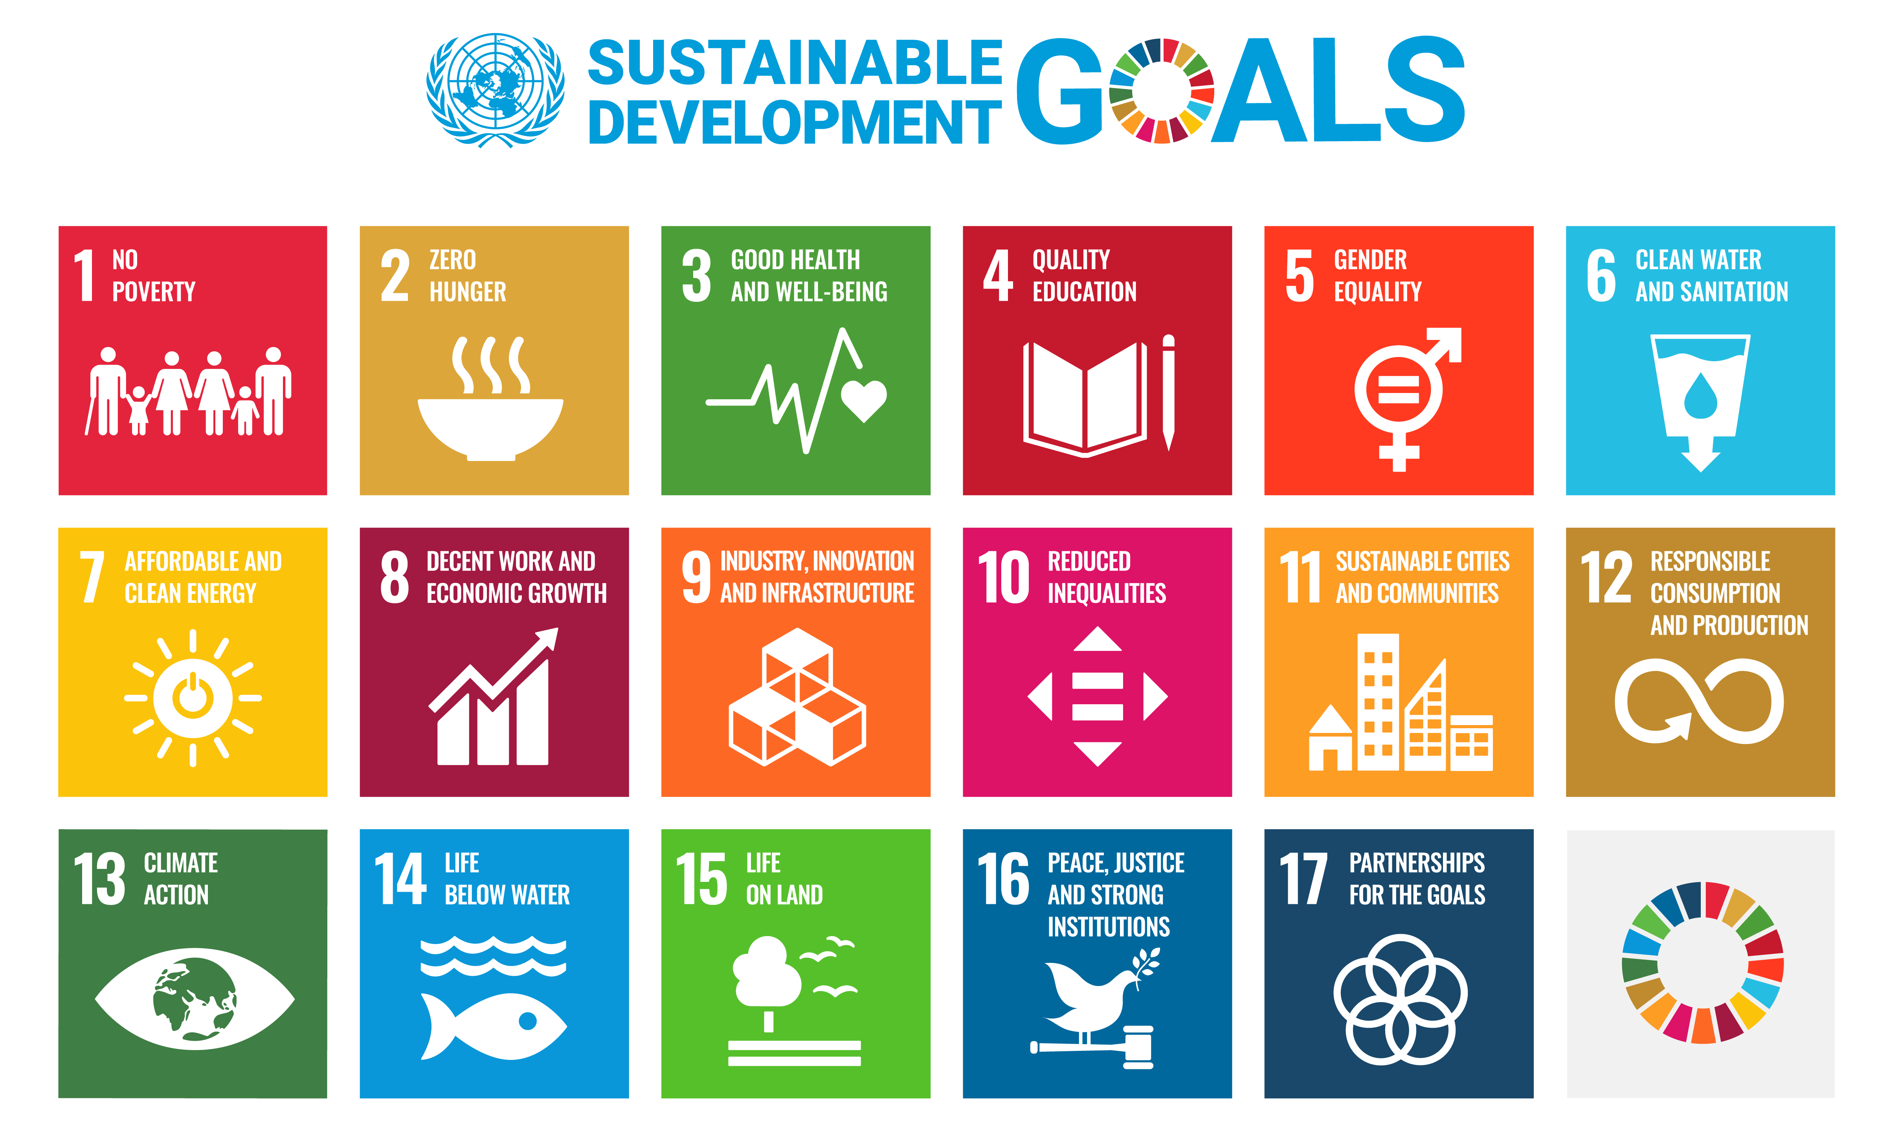
Project work mapping with SDG
This project aligns with SDGs 4 and 8 by promoting inclusive education and economic empowerment for individuals with hearing impairments. Under SDG 4 (Quality Education), it enhances accessibility in learning environments by converting Indian Sign Language (ISL) into text and speech, enabling seamless communication in classrooms and digital education platforms. Simultaneously, it supports SDG 8 (Decent Work and Economic Growth) by fostering workplace inclusion, expanding job opportunities, and enabling professional interactions for individuals with hearing disabilities. By integrating AI-driven translation, the project ensures equal access to education and employment, contributing to a more inclusive and sustainable society.

Slide 21
Thank You

